Slide 1

IBM – SMARTBRIDGE
INTELLIGENT CARGO MANAGEMENT SYSTEM using iot
PRESENTED BY
VSSR

Slide 2
INTRODUCTION: Cargo Management
The main purpose of this project is to developing for where daily many customers sends goods from one country, state to other country.
In order to deliver goods in given time management system must be computerized and reduce manual work and provide better quality.
The perishable products are to be delivered at the desirable quality in the right time. The lack of constant monitoring of the product during the freight contributes towards the food wastage during the transportation phase.

Slide 3
The sensors are deployed inside the truck to monitor the freshness of the product. Various parameters like temperature, humidity and the air quality inside the truck are monitored. An app is designed for receiving all the parameters through Bluetooth communication.
Project Highlights
Bluetooth Communication between Device and Mobile Application.
Usage of Bluetooth module and its configuration.
Building the mobile Application using Android ( MIT app inventor)
Sending the alert messages through the mobile application if required.

Slide 4
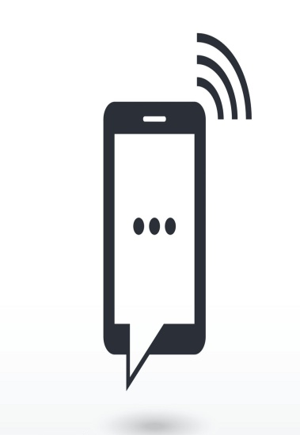

BLOCK DIAGRAM:-
INPUT
OUTPUT
MQ135
DHT 11
controller
Node MCU(esp8266)

Slide 5
Components required :
HARD WARE :
GPS
DHT 11
NODEMCU
MQ -135
HC-05 MODULE
SOFTWARE :
ARDUNIO
MIT APP INVENTOR

Slide 6
GPS :
"Global Positioning System." GPS is a satellite navigation system used to determine the ground position of an object.
The GPS system includes 24 satellites deployed in space about 12,000 miles (19,300 kilometers) above the earth's surface. They orbit the earth once every 12 hours at an extremely fast pace of roughly 7,000 miles per hour (11,200 kilometers per hour). The satellites are evenly spread out so that four satellites are accessible via direct line-of-sight from anywhere on the globe.

Slide 7
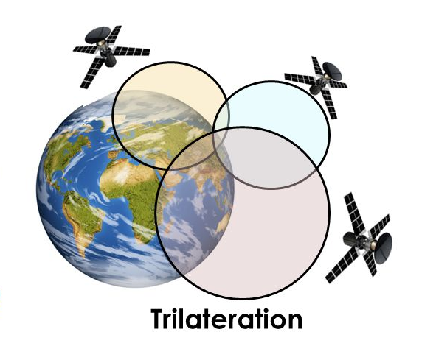
Satellites :
Satellites are basically equipment platforms located in space. Each satellite has a 'payload' which describes its purpose. For example a satellite fitted with radio equipment is a 'communication satellite'. On the other hand a satellite fitted with weather measuring instruments is a 'weather satellite'.
Communication satellites send and receive data from one point on the Earth to another point on the Earth.

Slide 8
Here's how GPS works in six steps:
GPS works by using a method called "triangulation" or "trilateration".
It needs to get a message from at least three, preferably four satellites
To "triangulate", a GPS receiver measures the distance between itself and each satellite. It can measure distance because it works out exactly how long it took for each satellite's message to arrive. (distance = time of arrival * speed of light)
To measure travel time, GPS needs very accurate timing which it achieves with atomic clocks on board each satellite.
Along with distance, the device needs to know exactly where the satellites are in space at any given time. This information is held inside the GPS receiver itself.
Finally, because it knows exactly where the satellites are at that instant, by using some very clever mathematics, it can work out where it is on the ground.

Slide 9
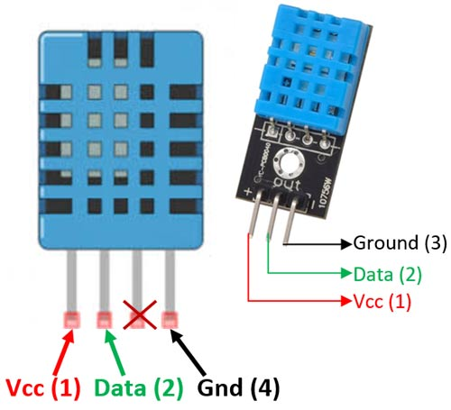
DHT11
The DHT11 is a basic, ultra low-cost digital temperature and humidity sensor. It uses a capacitive humidity sensor and a thermistor (NTC temperature sensor) to measure the surrounding air.
NTC = negative temperature coefficient
DHT 11 consists of four pins :
1. Vcc
2. data
3. not connect
4. ground

Slide 10
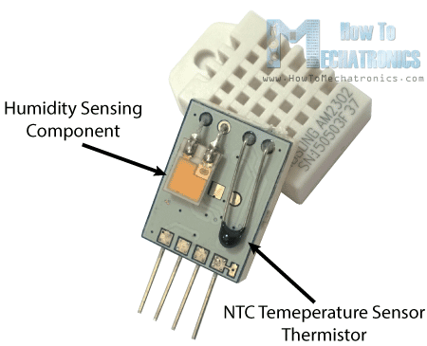
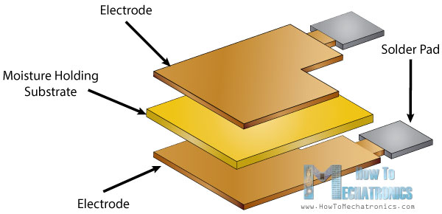
WORKING
HUMIDITY SENSOR
humidity sensing component which has two electrodes with moisture holding substrate between them. So as the humidity changes, the conductivity of the substrate changes or the resistance between these electrodes changes. This change in resistance is measured and processed by the IC which makes it ready to be read by a microcontroller.

Slide 11
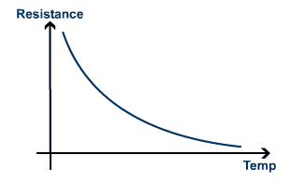
NTC temperature (thermistor)
Thermistor is actually a variable resistor that changes its resistance with change of the temperature. These sensors are made by sintering of semi conductive materials such as ceramics or polymers in order to provide larger changes in the resistance with just small changes in temperature. The term “NTC” means “Negative Temperature Coefficient”, which means that the resistance decreases with increase of the temperature.

Slide 12
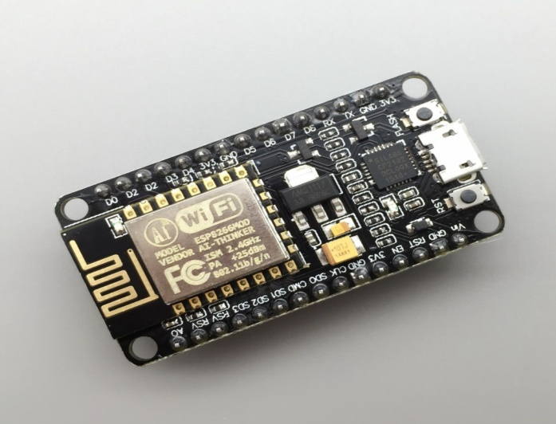
Node mcu (esp 8266)
NodeMCU is an open source IoT platform. It includes firmware which runs on the ESP8266 Wi-Fi SoC from Espressif Systems, and hardware which is based on the ESP-12 module.
NodeMCU was created shortly after the ESP8266 came out. On December 30, 2013, The ESP8266 is a Wi-Fi SoC integrated with a Tensilica Xtensa LX106 core
It supports python ,embraded c, url spectral languages.
It is a 32-bit controller.
It has 4 mb flash memory and 128 kb memory.

Slide 13
Clock speed is 80mhz to 160 mhz.
It has 13 GPIO pins (general purpose input output )
GPIO pins are used to connect different sensors and activators.
One ADC convertor pin (analog to digital ). The range of analog pin is 0 to (2^10-1)
It support TCP and IP.
ESP8266 support 2.4ghz

Slide 14
MQ-135
Air quality sensor for detecting a wide range of gases, including NH3, NOx, alcohol, benzene, smoke and CO2.
Ideal for use in office or factory.
It is also sensitive to smoke and other harmful gases.
It is with low cost and particularly suitable for Air quality monitoring application.
The operating voltage of this gas sensor is from 2.5V to 5.0V.
It is range up to <100m.
Features:
High Sensitivity
Stable and Long Life
Detection Range: 10 - 300 ppm NH3, 10 - 1000 ppm Benzene, 10 - 300 Alcohol
low cost

Slide 15
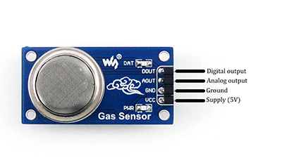
Air Quality Sensor (MQ135)
It consists of 4 pins.
Pin Description
Pin Number Pin Name Pin Description
1. Vcc : Used to power the sensor, Generally the operating voltage is +5V.
2 . Ground : Used to connect the module to system ground.
3 . Digital Out : You can also use this sensor to get digital output from this pin, by setting a threshold value using the potentiometer.
4. Analog Out : This pin outputs 0-5V analog voltage based on the intensity of the gas.

Slide 16
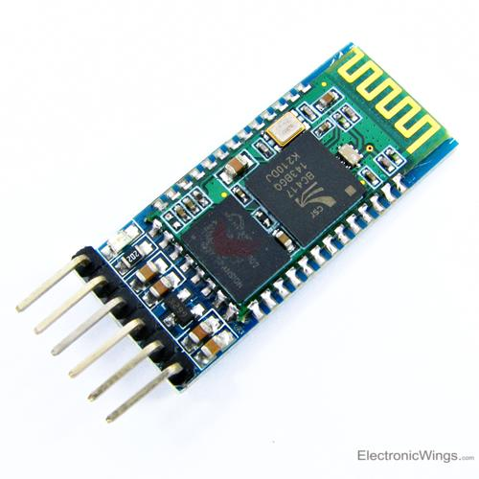
HC-05 BLUETOOH MODULE
HC-05 is a Bluetooth module which is designed for wireless communication. This module can be used in a master or slave configuration.
HC-05 has red LED which indicates connection status
This module works on 3.3 V. We can connect 5V supply voltage as well since the module has on board 5 to 3.3 V regulator.
The range is less than 10mts.

Slide 17
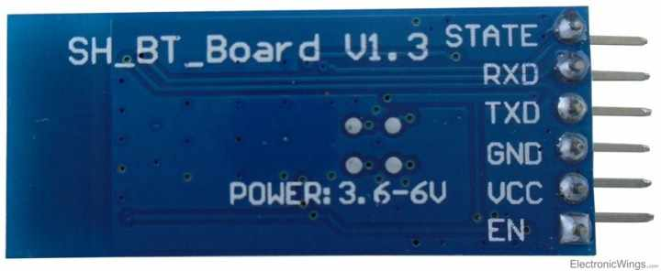
PIN DESCRIPTION
It has 6 pins
Key/EN: It is used to bring Bluetooth module in AT commands mode.
HC-05 module has two modes,
1. Data mode: Exchange of data between devices.
2. Command mode: It uses AT commands which are used to change setting of HC-05.
VCC: Connect 5 V or 3.3 V to this Pin.
GND: Ground Pin of module
TXD: Transmit Serial
RXD: Receive data serially
State: It tells whether module is connected or not.

Slide 18
ARDUINO IDE
1. Arduino is an open source electronic platform based on easy to use
Hardware and software.
2. The arduino integrated development environment(IDE) is a cross
Platform application (for windows, mackos, linux) that is written in
Programming language JAVA.
3. The arduino IDE supplies software library from the wiring project,
Which provides many common input and output procedures.
4. Arduino boards are able to read inputs-light on sensor ,finger on a button, publishing something online
5. The user writes the arduino code in the IDE, then uploads it to the
Microcontroller which executes the code, interacting with inputs and out puts Such as sensors and lights.

Slide 19
ANDROID MIT APP INVENTOR
The app inventor team was led by Hal Abelson and Mark Friedman.
In the second half of 2011, Google released the source code, terminated its server, and provided funding to created the MIT center for mobile learning
The app inventor lets you develop application for android phones using a web browser and either a connected phone or emulator.
The app inventor servers store your work and help you keep track of your projects
MIT app inventor is an intuitive, visual programming environment that allows everyone-even children-to build fully functional apps for smart phones and tablets.

Slide 20
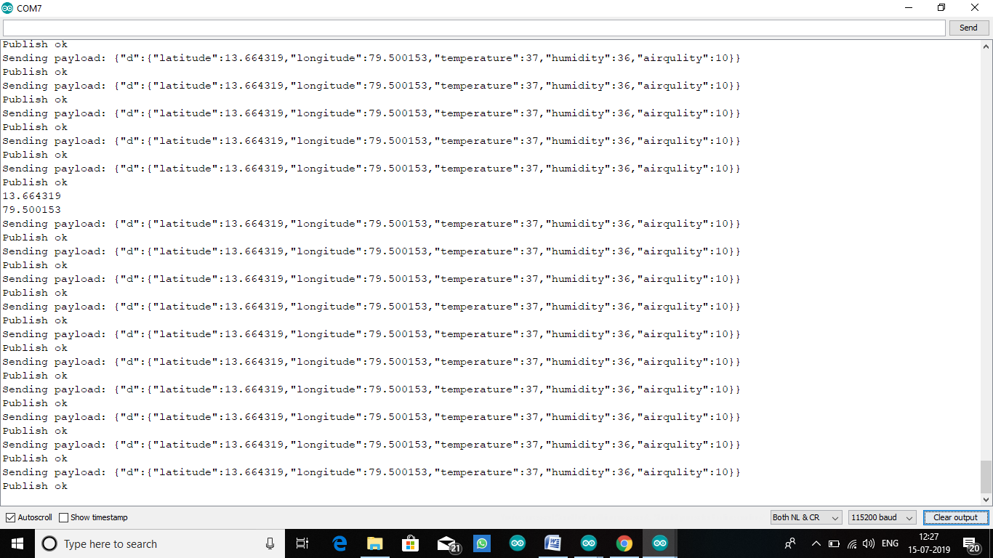
OUTPUT FROM SERIAL MONITOR

Slide 21
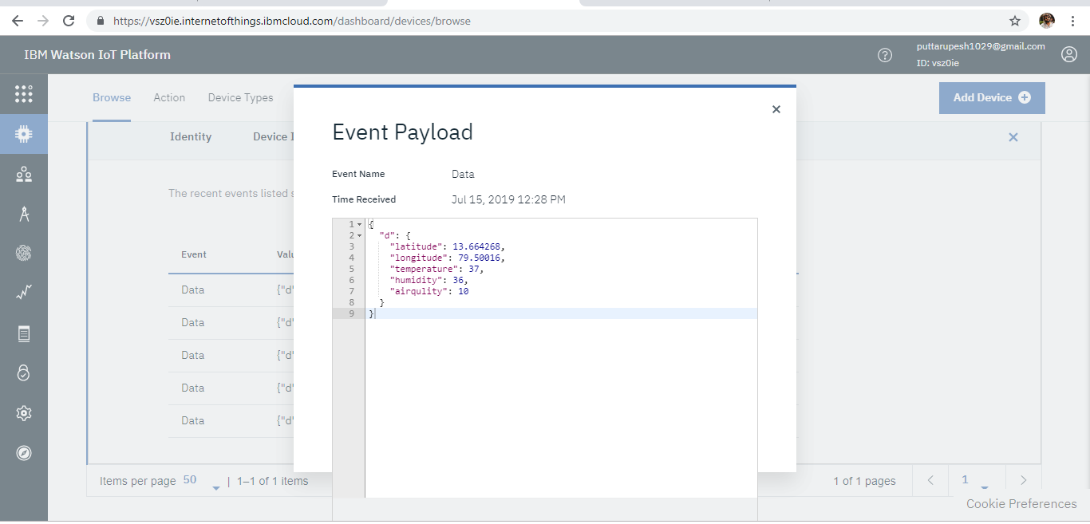
OUTPUT FROM IBM WATSON :

Slide 22
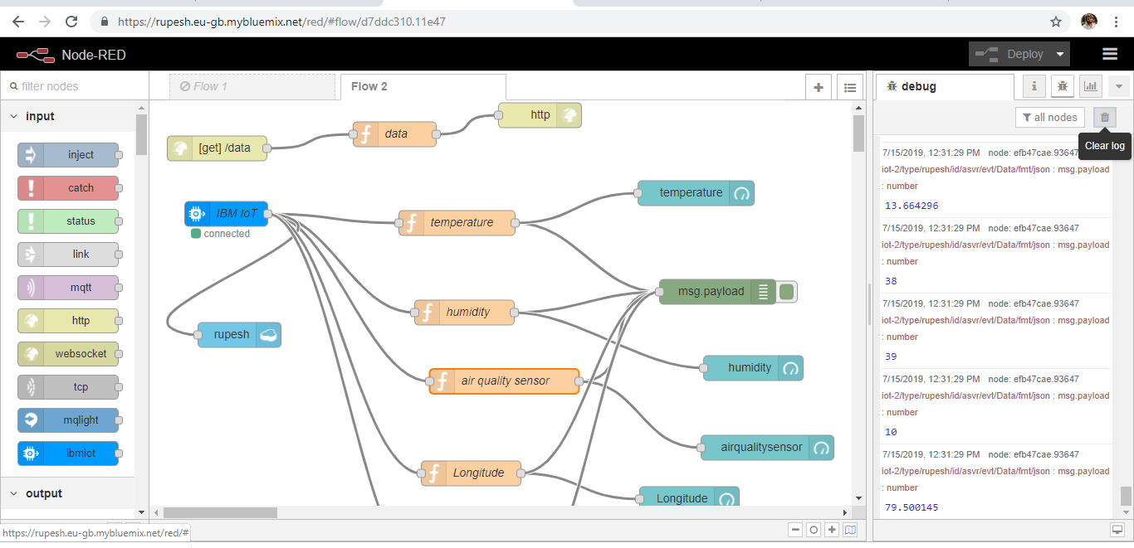
OUTPUT FROM NODE RED :

Slide 23
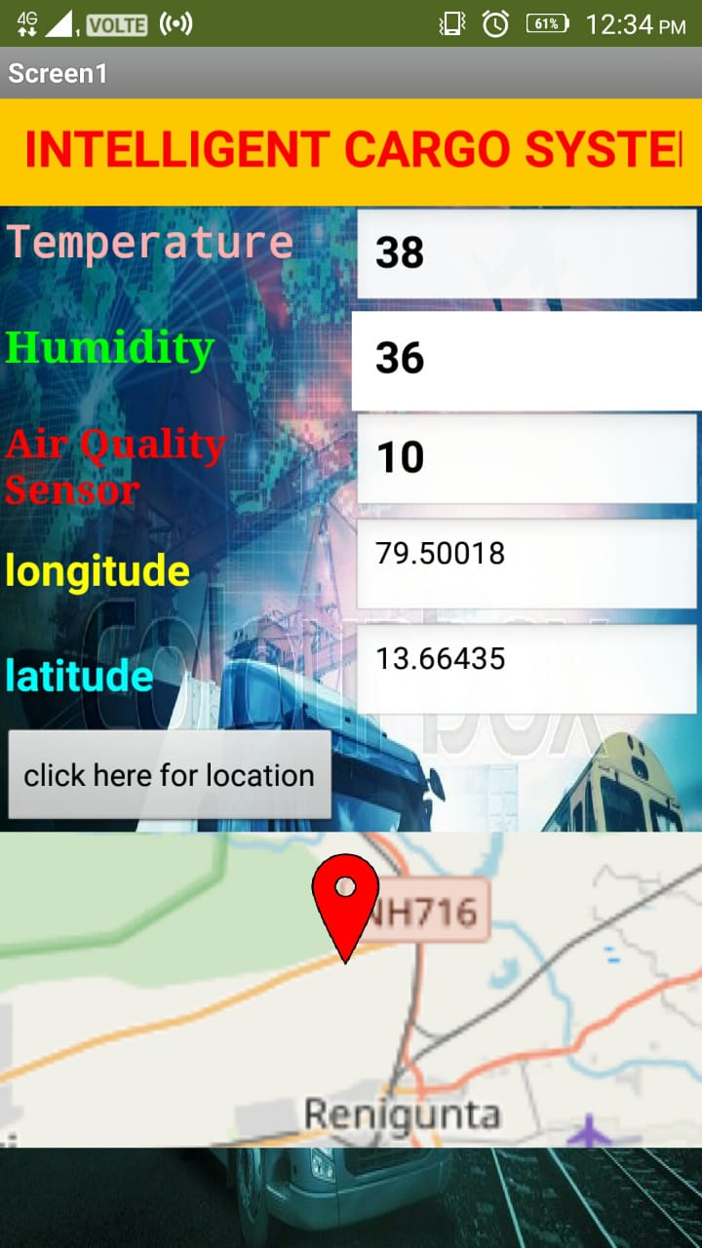
OUTPUT FROM MIT APP INVENTOR :

Slide 24

THANKING YOU
THANK YOU

